Slide 1
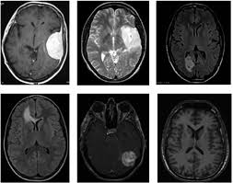
IDEA – 1 : Brain Tumor detection using Deep Learning

Slide 2
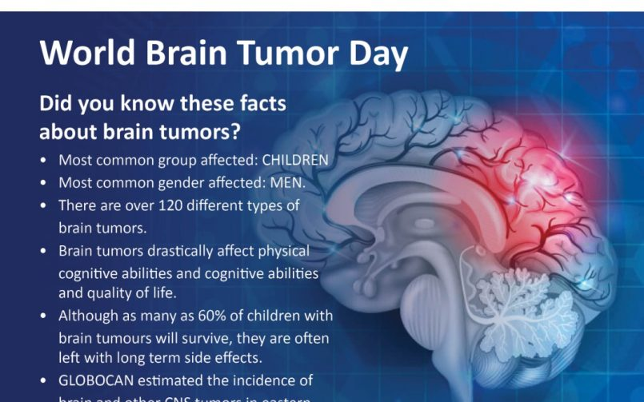
What is Brain Tumor?
A brain tumor is a mass or growth of abnormal cells in your brain.
Many different types of brain tumors exist. Some brain tumors are noncancerous (benign), and some brain tumors are cancerous (malignant). Brain tumors can begin in your brain (primary brain tumors), or cancer can begin in other parts of your body and spread to your brain as secondary (metastatic) brain tumors.
Brain tumor treatment options depend on the type of brain tumor you
have, as well as its size and location.

Slide 3
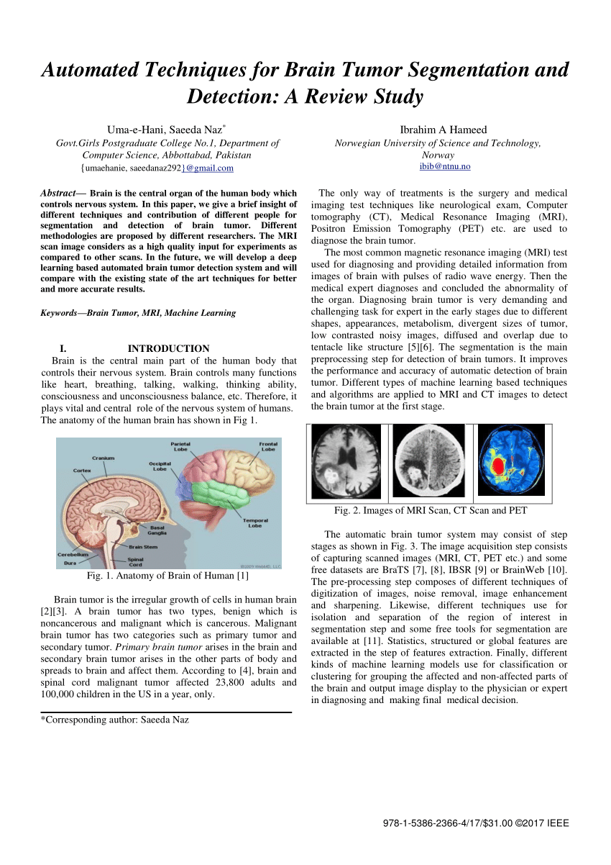
Why we decided to choose this topic ?
This project deals with such a system, which uses computer, based procedures to detect tumor blocks and classify the type of tumor using Convolution Neural Network Algorithm for MRI images of different patients.
The main motivation behind Brain tumor detection is to not only detect tumor but it can also classify types of tumor. When these algorithms are applied on the MRI images the prediction of brain tumor is done very fast and a higher accuracy helps in providing the treatment to the patients.
These prediction also helps the radiologist in making quick decisions. In the proposed work, a self defined Artificial Neural Network (ANN) and Convolution Neural Network (CNN) is applied in detecting the presence of brain tumor and their performance is analyzed..

Slide 4
Our Workflow and Procedure to make this Project:
Dataset source : https://www.kaggle.com/ahmedhamada0/brain-tumor-detection
Platform For Building the model : Google Colab
Deployment software : Streamlit (https://streamlit.io/)
Application :

Slide 5
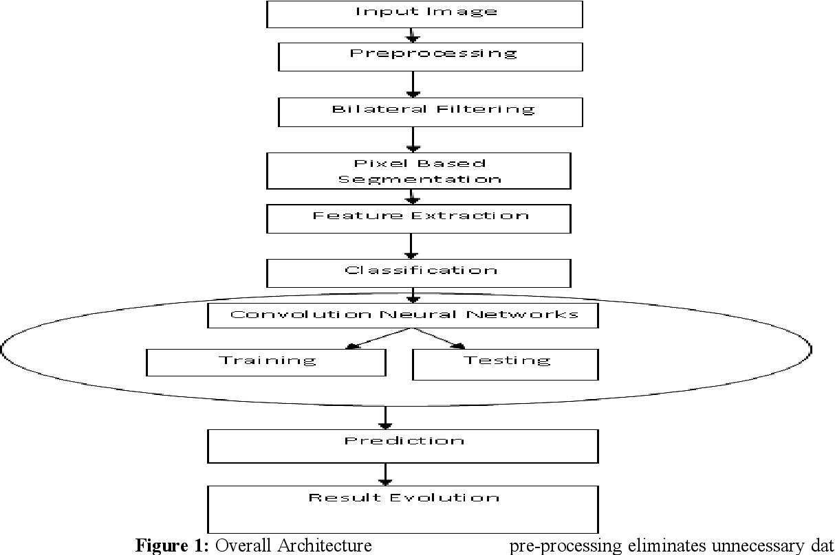
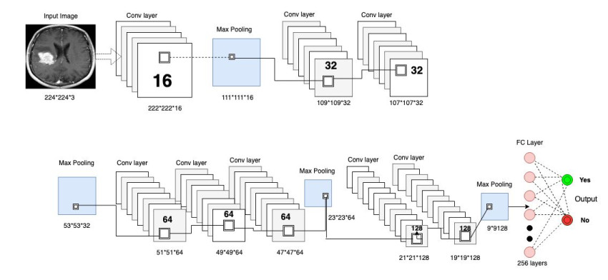
MODEL ARCHITECTURE
Overall Architecture
Neural Network Architecture

Slide 6
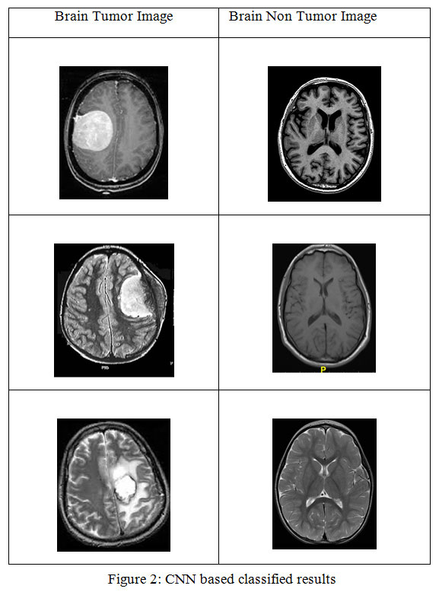
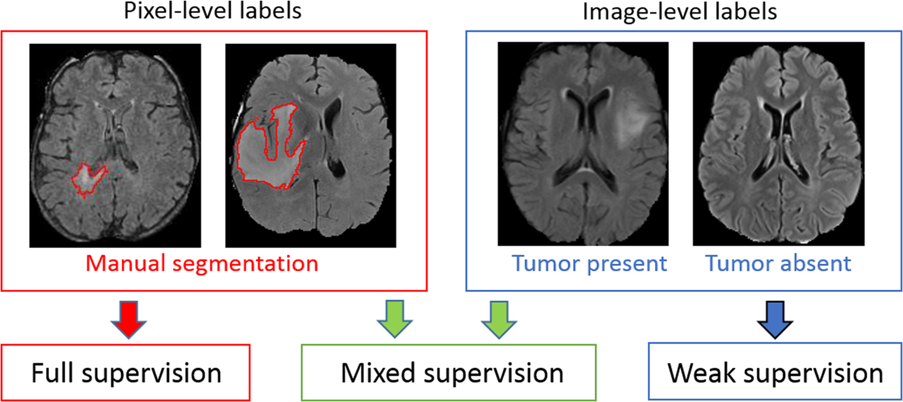
Expected Outcome

